Slide 1

Angular Components Lifecycle
Curs 4:

Slide 2
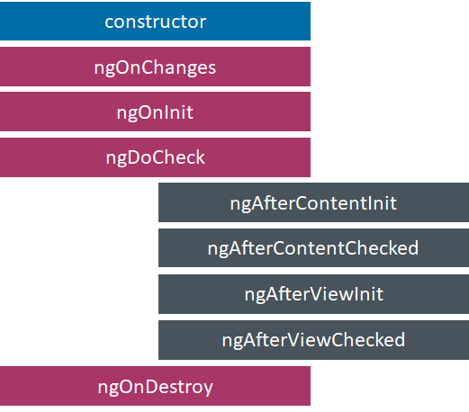
Angular Component Lifecycle Hooks

Slide 3
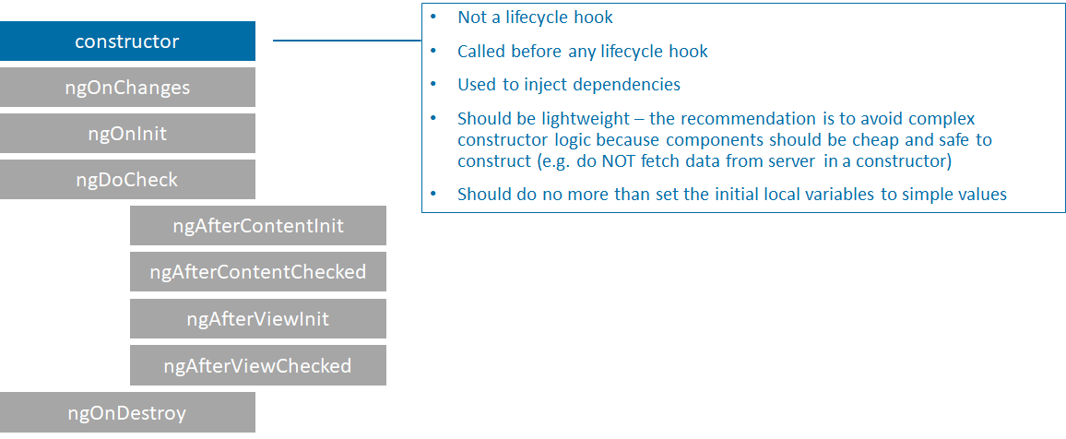
Constructor

Slide 4
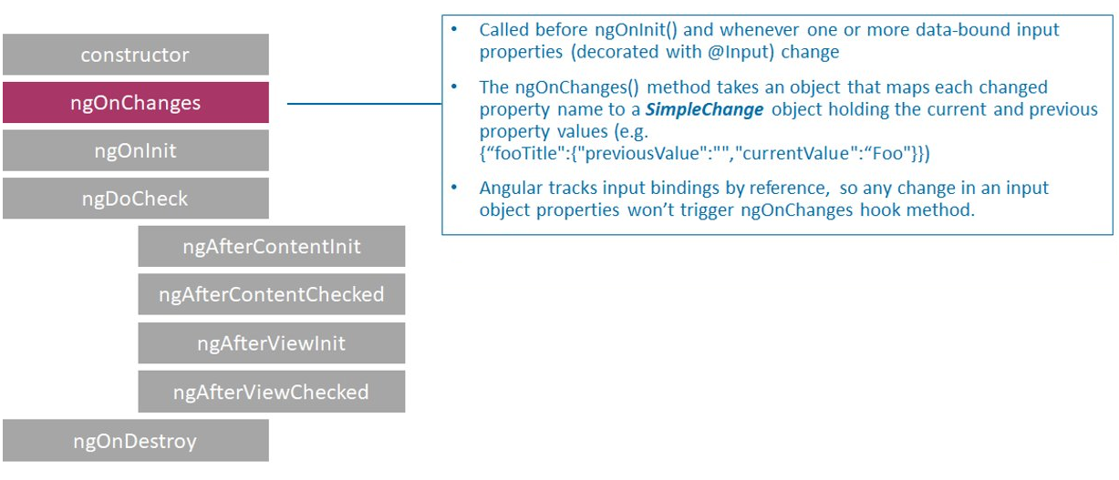
NgOnChanges

Slide 5
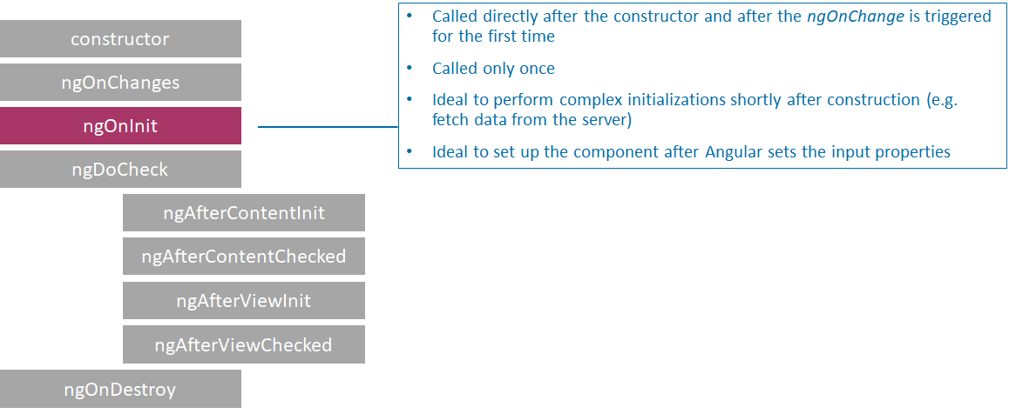
ngOnInit

Slide 6
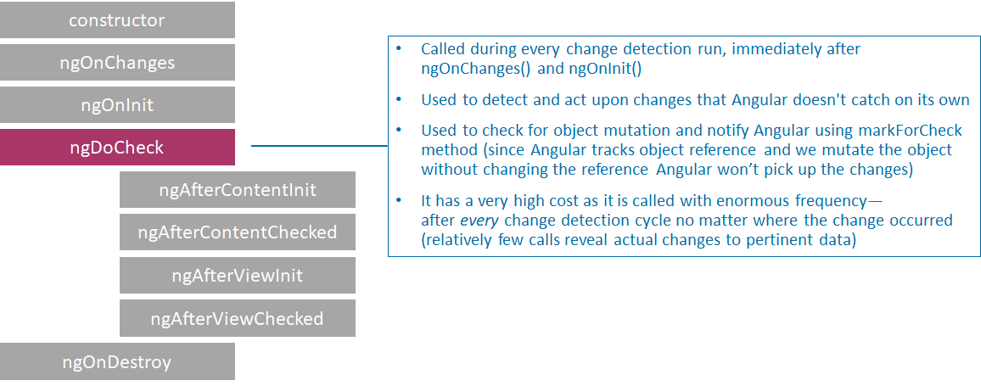
ngDoCheck

Slide 7
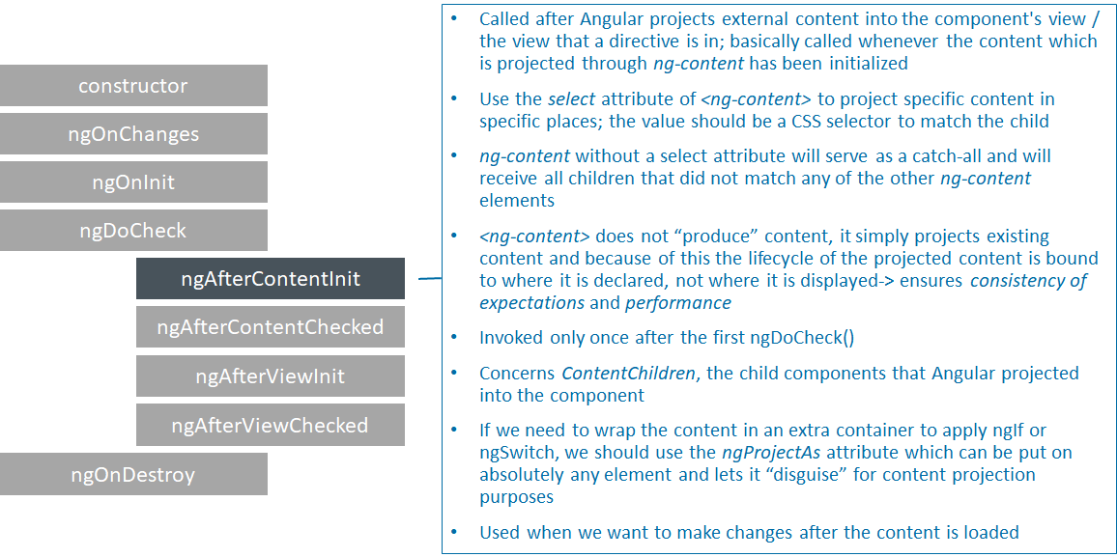
ngAfterContentInit

Slide 8
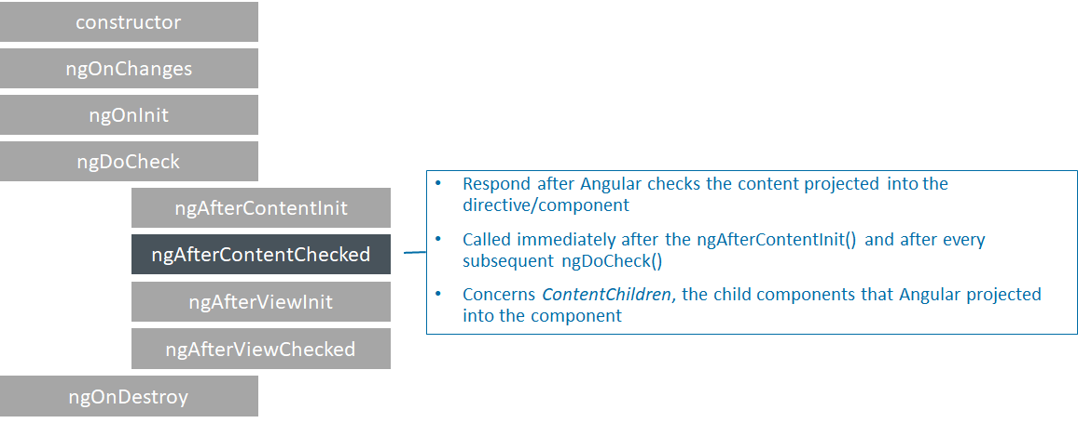
ngAfterContentChecked

Slide 9
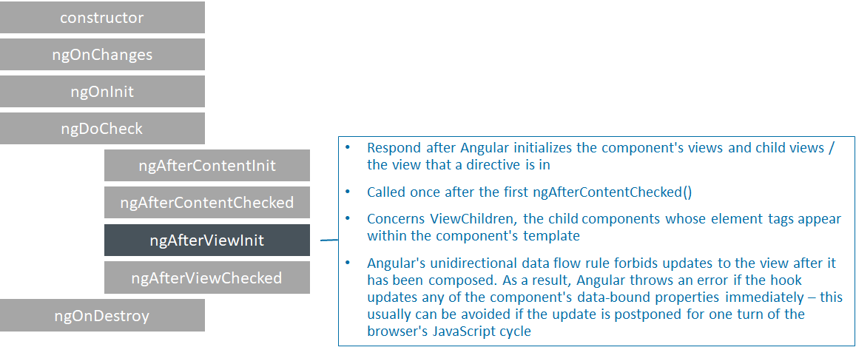
ngAfterViewInit

Slide 10
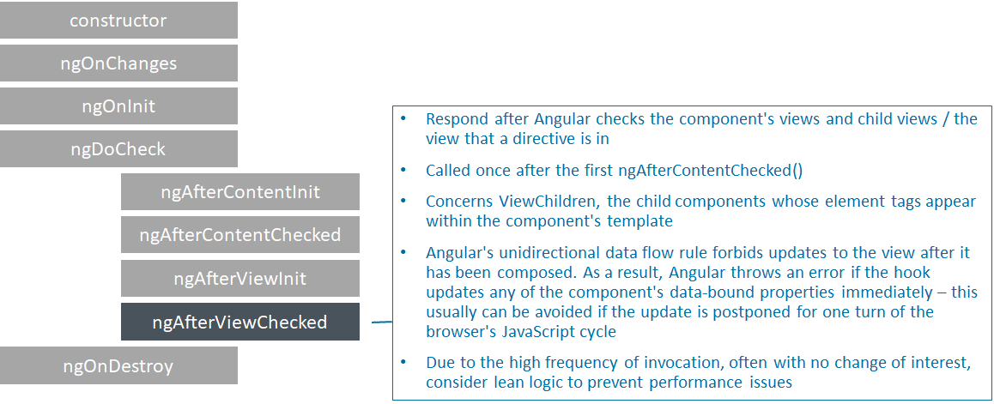
ngAfterViewChecked

Slide 11
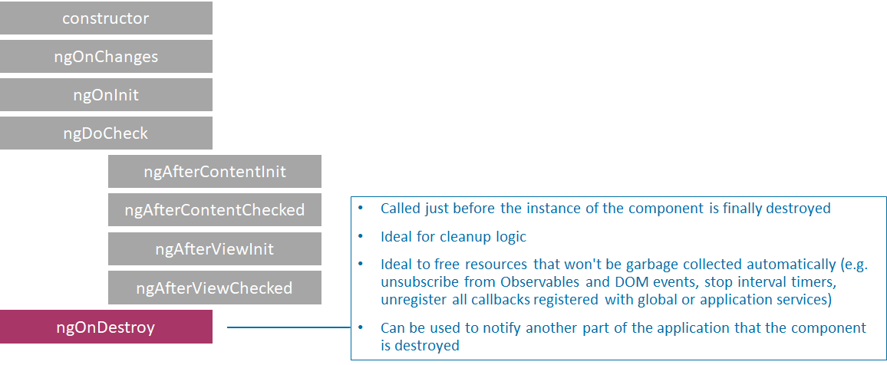
ngOnDestroy

Slide 12
References
https://angular.io/guide/lifecycle-hooks

